Slide 1

Spotify Streaming Trends & Platform Performance Analysis (2020–2023)
By Ubed and Anand

Slide 2
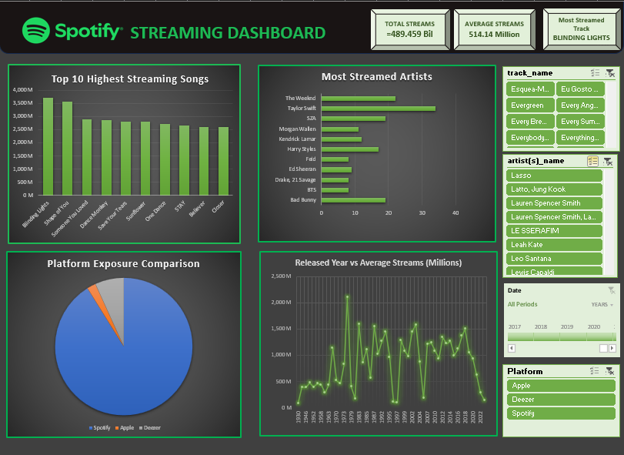

Slide 3

Project Overview
Key Metrics (KPIs):
Total Dataset Size: 953 Tracks.
Top Song: Blinding Lights by The Weeknd (~3.7B Streams).
Leading Artist: Taylor Swift (34 appearances in the dataset).

Slide 4
Questions
Which top 10 songs have the highest streams?
Which artists appear most frequently?
Which platform gives the highest exposure, Spotify, Apple, or Deezer
Has song popularity increased over years?

Slide 5
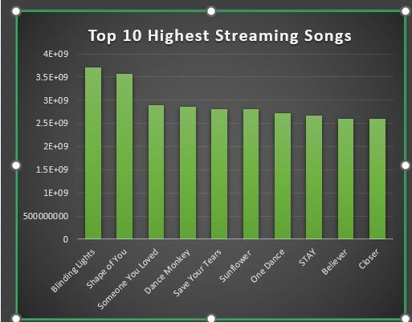
Top 10 Global Hits (by Streams)
Blinding Lights (3.7B)
Shape of You (3.5B)
Someone You Loved (2.8B)
Dance Monkey (2.8B)
Save Your Tears (2.8B)

Slide 6
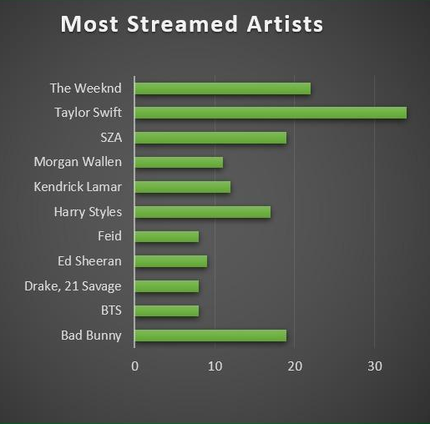
Most Streamed Artists
Most Frequent Artists:
Taylor Swift: 34 Songs
The Weeknd: 22 Songs
SZA / Bad Bunny: 19 Songs each

Slide 7
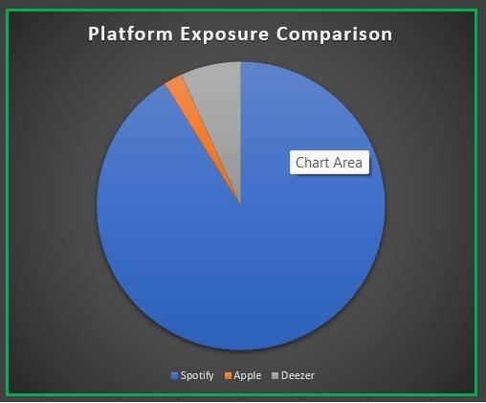
Platform Performance:
Spotify vs. Apple vs. Deezer
Spotify Playlists:
~4.9M total inclusions.
Deezer Playlists:
~367k total inclusions.
Apple Playlists:
~64k total inclusions.

Slide 8
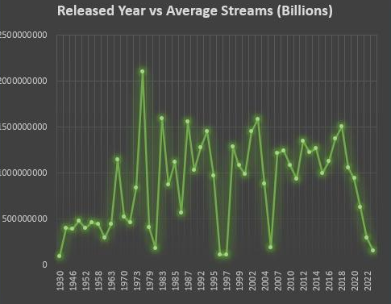
Release Year &
Streaming Longevity
While 2022 and 2023 have the highest volume of tracks, years like 2020 maintain higher average streams per song.

